Slide 1





Basic
Chart Updating
AV-PQS Training

Slide 2
Auxiliary CU Activities
covered in this session
Overview of Nautical Chart Update Program
Overview of Chart Update Training Guide
Plans, Procedures and Reports
Expectations and Results
Overview of NOAA ASSIST Report
Live Report Sessions

Slide 3
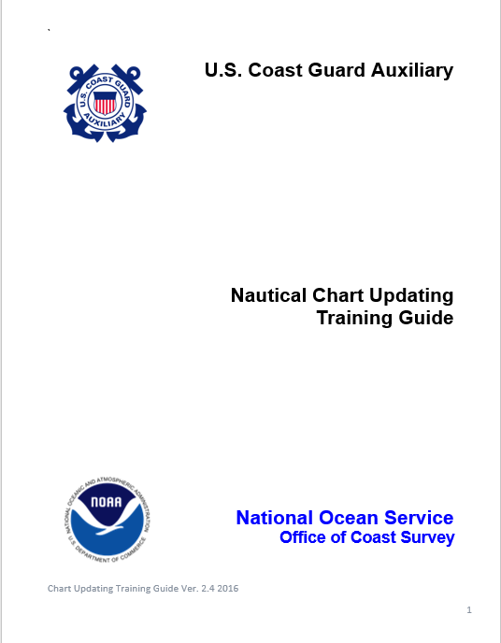
UPDATED

Slide 4
NOAA Needs Our Help
Why We Matter:
Safe boating requires up-to-date charts.
Funding is a limiting factor for NOAA.
There is a critical shortage of quality reporting and reporters.
USCGAUX members are well qualified due to their training and experience.
Coastal Piloting experience in AOR
Underway operations experience in AOR.
Extensive local knowledge in AOR.

Slide 5
Your Operational Role
All Auxiliary vessels while underway should be checking all Aids to Navigation and charted features for any type of discrepancy on Nautical Charts.
Report ATON discrepancies with a hard copy report within 48 hours or 14 days for verifications
Don’t forget 60-day window for Mission Hour Report

Slide 6
Chart Updating Activity
Individual Chart Update reports and Coast Pilot reports may be done by any Auxiliarist, at any time, on any chart
Proper training is desirable if the Auxiliarist wants to be successful, preforming and reporting any Chart Updating activity

Slide 7
The Focus for the AUXILIARY
Chart Updating Program
Accuracy
      Sensible program guidelines and online help topics
  Simple forms to help organize the data
Quality and Credibility
  Pre-underway checks to insure measuring equipment is operating accurately
  On-scene quality control checks to insure measuring equipment is still accurate
Professionalism
  Comprehensive worksheets
  Web generated reports

Slide 8
  Chart Updating Process
  Compare the nautical chart to what you see
  Gather the evidence
  List your observations and comments – the proof and evidence of your statement
  Over selling your point is OK
  Provide a logical recommendation to NOAA based on the evidence provided

Slide 9
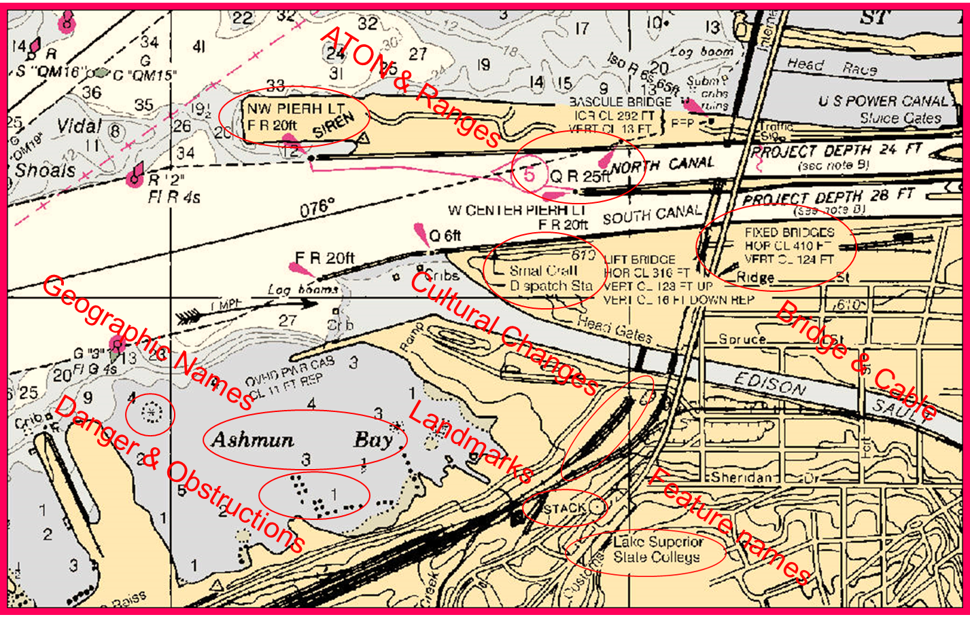
CU Reportable Items

Slide 10
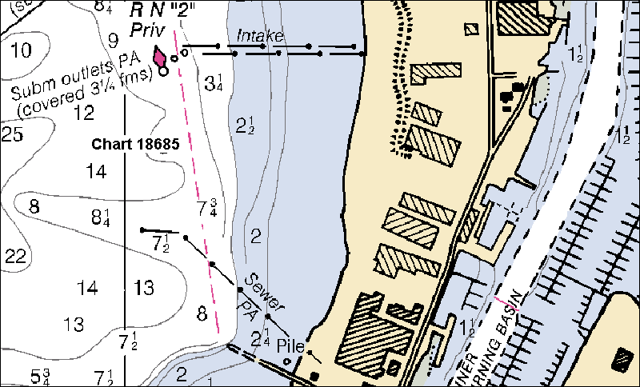
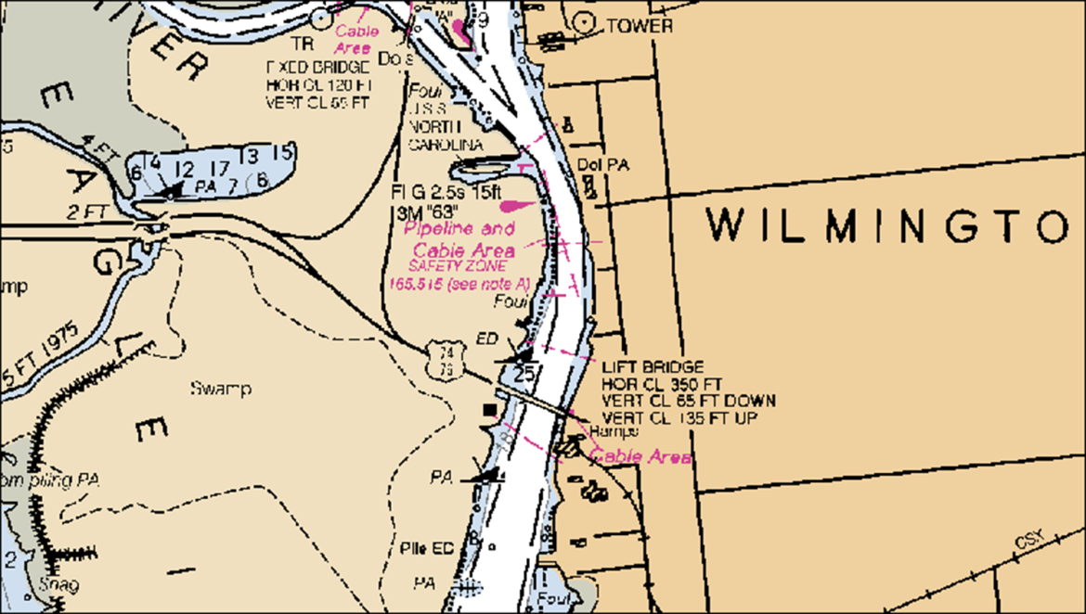
CU Reportable Items
Buildings
Pipelines
Marinas & Piers
Visible Wrecks

Slide 11
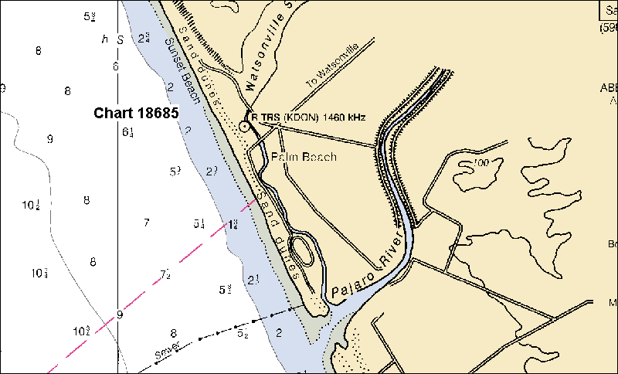
CU Reportable Items
Landmarks

Slide 12
Information about New Landmarks
  Is the item significant enough to be used as a landmark by mariners?
  What are the characteristics (function, color, construction material). Is it lighted? If so, what are the light characteristics?
  What is it’s geographic position? An accurate GPS derived position is ideal. If a gps is used, please note what type of gps / dgps was used and also whether any post processing corrections have been applied.
  Who is the owner of this feature and how long has it been there?
  Is the charted landmark still useful or is it obscured or distroyed?

Slide 13

Uncharted Hazards
  What type of hazard is it? (i.e. rock, shoal, wreck, debris, coral, other).
  What is its geographic position or extents and how was this information obtained?
  Is this a newly discovered hazard or one that has been known about for some time?
  Is there a known or reported least depth over the feature? If so, how was it obtained?
  Any other relevant information (are there plans for the removal of this feature? How was the feature discovered?
  Is the feature marked with a buoy or warning of some sort?

Slide 14
Shoreline Discrepancies
  Is the shoreline in question manmade or natural?
  Is it a significant discrepancy at chart scale?
  If the shoreline is of a man-made nature, can as built engineering drawings be acquired that will remedy the situation?
  As will all chart submissions, please include a chart graphic showing the extent of miss charted shoreline.

Slide 15
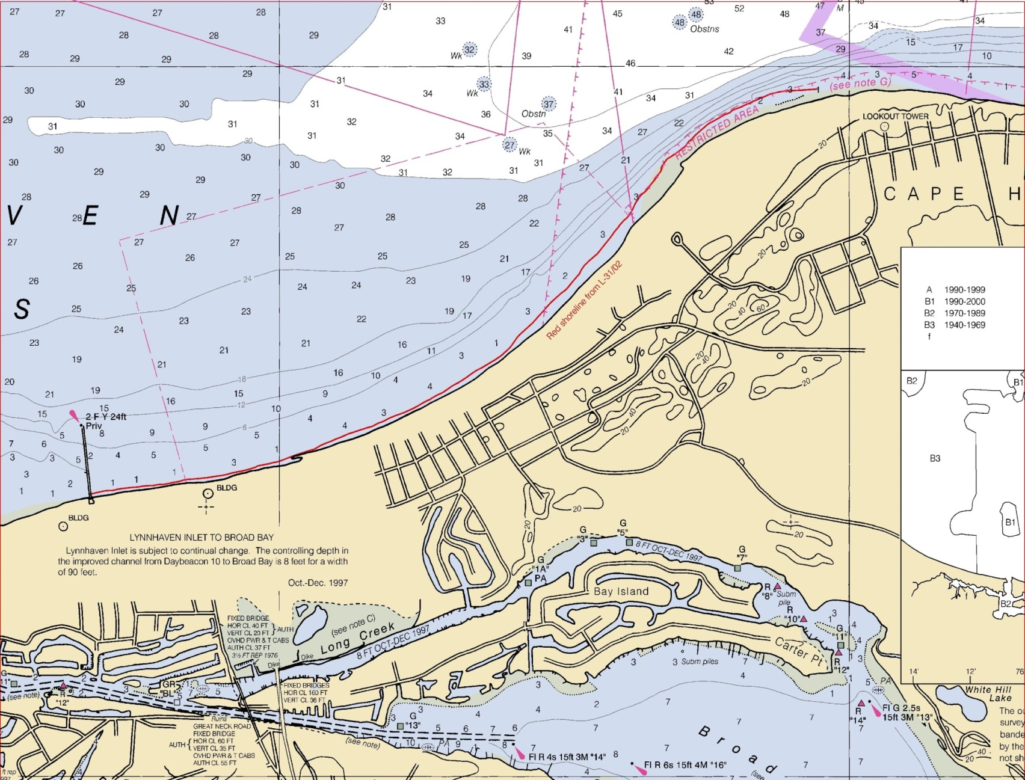
Shoreline Discrepancies

Slide 16
Cultural Changes

Slide 17
Geographic Names
  Geographic Names are charted based on the United States Geological Survey’s (USGS) Geographic Names Information System (GNIS) database. Only the official name, or a variant can be charted. You can search the GNIS database online by visiting: https://www.usgs.gov/core-science-systems/ngp/board-on-geographic-names/domestic-names
  Changing a name is a process that begins with a proposal to the Geographic Names Board and can be done online. The process of proposing a new name or changing an existing name is started by visiting the same link (above).
  (shows as geonames.usgs.gov)

Slide 18
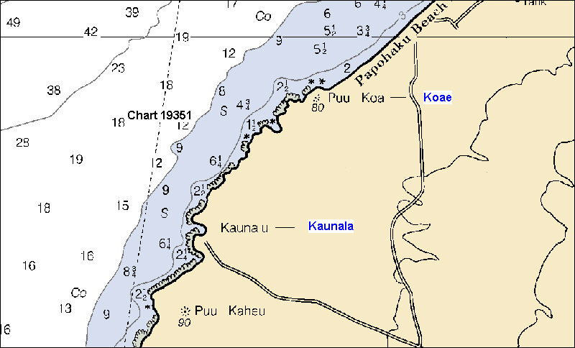
Geographic Names
Look for misspelled Geographic Names.
Reference the correct spelling from the GNIS

Slide 19
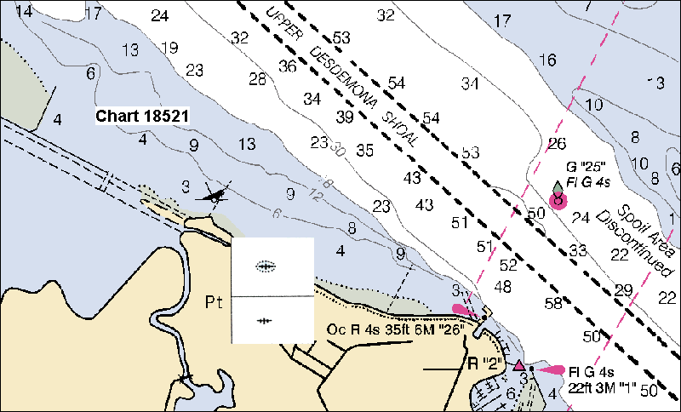
Dangers to Navigation
Has this wreck been removed? Prove with photos taken on the charted location at low water (if bared), and with a fix.
Alternatively, if you can get documentation from the salvor, that can substantiate this removal for many more obstructions.

Slide 20
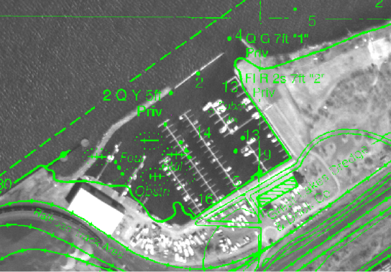
Change Analysis
Using Imagery
The green lines represent the existing charted lines, symbols, and configurations.

Slide 21
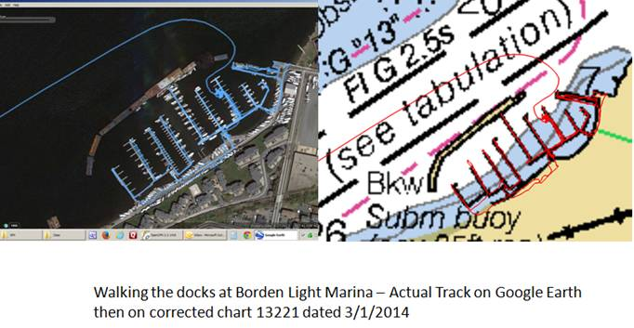
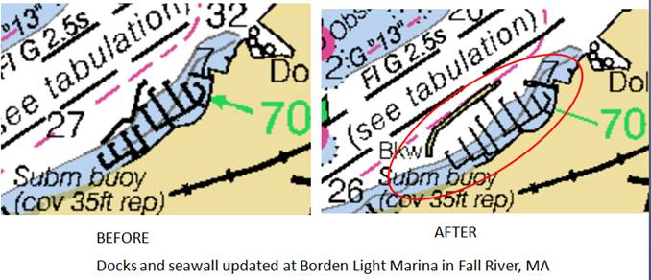
Change Analysis
Using Imagery

Slide 22
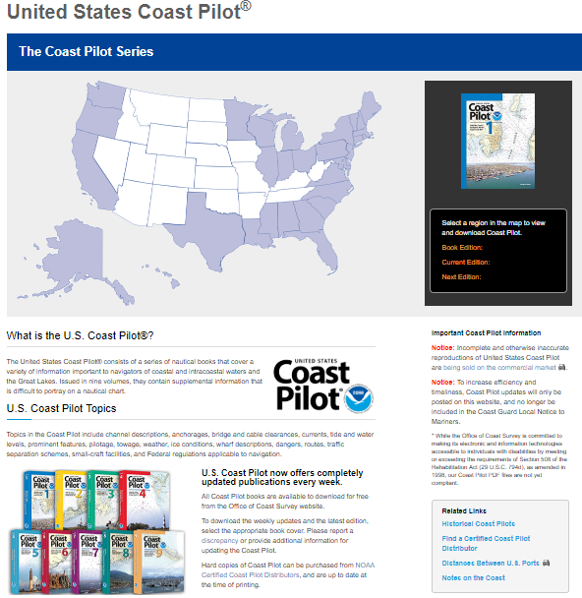
Chart Updating Program
Coast Pilot Review
Updated publications every week
Available to download for free
Hard copies can be purchased from NOAA Certified Coast Pilot Distributors
Now contains “Rules of the Road”
https://nauticalcharts.noaa.gov/publications/coast-pilot/index.html

Slide 23
Chart Update
Coast Pilot Program
Describe navigation dangers during entry in to port or harbor
Shore side transportation
Haul out availability
Phone Numbers for Harbormaster offices and CG District Offices
Location of the Harbor Master’s Office and CG Stations
Radio communications
Logistics (food/water)
Marine Repair Capability
Coast Pilot Manual at:
http://wow.uscgaux.info/Uploads_wowII/P-DEPT/Coast_Pilot_Manual__2010_.pdf

Slide 24
Coast Pilot Updates
Always validate your Chart Update observations to the narrative in the latest Coast Pilot.
Always compare the information published in the Coast Pilot to what you actually observe on scene.
Is the information accurate and complete?
Reference:
Edition of the Coast Pilot,
Page and Paragraph number(s) in question.

Slide 25


Small Craft Facilities
NOS no longer accepts Small Craft Facility table information, nor do they display that SCF Table on Small Craft Charts anymore.
Only facilities that meet the following five criteria will be charted (see icons below):
1. Open to the public
2. Sell gasoline or diesel fuel
3. Have a pump out facility
4. Have transient berths or moorings
5. Give an approach depth and an alongside depth
NOS still accepts As-Built drawings for new marinas.
Reports may be entered in NOAA’s ASSIST as an “Error Report”.

Slide 26
Aids to Navigation
Validate that the aid matches the symbols and abbreviations displayed on a nautical chart,
Charted symbols and position should match the specifications in the Light List
Do not confuse Discrepant reporting (to CG Sector/Group) with charted position errors. See USCGAUX National ATON Training Guide
Any discrepancies on the symbols, abbreviations, and charted position are reportable to NOAA.
pay particular attention to the color and font of the buoy symbol.

Slide 27
Observation Support
Define the object you are investigating with a brief statement.
Gather & list the evidence that proves your point.
Location and Depth data, photos
Interview Information (obtained from credible)
List your observations, proof & evidence
The comments substantiating your observation
Provide a logical recommendation to NOAA based on the
evidence provided.
Over-selling your point is OK.

Slide 28
Information Gathering
Interviewing Credible Sources
  Most human-caused changes have a credible source of information for the change. Get to know them:
  District offices of Army Corps of Engineers (USACE), Navigation Branch, Topographic Survey office, Regulatory/Permits office, Civil Works Operations Branch.
Online government databases
  State, county, and city government engineering/survey offices
Port Authority/Director engineering/operations offices
  Harbormasters and facility owner/operators. Note: Facilities can include businesses like boat/shipyards, private marina operators, owner/operators of wharfs/piers, property with charted landmarks

Slide 29
Information Gathering
Credible Sources
Interview other chart users in the area.
Local USCG Stations/Buoytenders/ANT Teams /Cutters
Local offices of USACE (US Army CoE)/vessels
Port Engineers (with Port Authority)
Marina Harbormasters
Commercial vessel captains (tug, etc.)
Harbor Pilots
Charter fishermen / Dive shops
Solicit local knowledge about:
Shoals; new obstructions – hangs
New construction / landmarks
Uncharted wrecks or rocks
Details in the Coast Pilot.

Slide 30
Support Information Needed
    As-Built Engineering Drawings of New Construction.
    Information regarding new Charting Landmarks.
    Reports of Uncharted Hazards (rocks, wrecks, obstructions, shoals).
    Information updates regarding marinas and other facilities.
    Reports of gross discrepancies between charted shoreline and actual shoreline.
    Salvage documentation for the removal of charted features (piles, wrecks, etc.)
    Other charted errors as well as chart recommendations.
    Incorrect, or out-of-date geographic names.

Slide 31
As Built and Construction
Drawings
These Drawings must have control (i.e. a way to accurately position them against the charts):
  This could be Geographic Positions, or a grid system such as State Plane Coordinates (or local grid, i.e., city-based plane coordinates).
  Also include Drawing’s map projection – Universal Transverse Mercator, etc.
  Ensure that other map specifics are clear - i.e., Units of measurement (feet, meters), and Datum (NAD27, NAD83)
  Please note when construction began, when it concluded.
  Any additional permit information about the new construction would be helpful (who is the owner of the structure, phone numbers of the owners, of the permitting official)
  Any other information that might assist in the charting and description of this facility

Slide 32
Salvage Documentation
Putting dangers or features on the chart is easy – taking them off can be difficult, particularly if they are in waters that do not completely uncover to the seabed at low tide.
If that is their condition, the easiest way to remove an item - like a wreck or pile - is to get a written statement on letterhead from the persons responsible for the salvage / removal indicating that the feature has been removed in its entirety and that no underwater hazards or debris remain. (For piles, this typically means they have removed below the mudline).
Without that statement, there’s little that can be done without a survey meeting NOS specifications. Sometimes, the symbology can be altered, and the abbreviation “ED” for Existence Doubtful can be added..

Slide 33
Support for Chart Updates
Interview other chart users in the area.
Dive shops
Marinas
Charter fishermen
Commercial vessel captains.
Pilots
Solicit local knowledge about:
Shoals
New obstructions – hangs.
Uncharted wrecks or rocks.

Slide 34
Taking Photos
Properly taken, photos are great evidence!
Use GPS to record the position of the object and also the spot where you take the photo (plus bearing of photo).
Plot both positions on your chartlet.
Record the time/date as you take each photo.
Keep a log of each photo so you can reference it to the discrepancy after development. Can assign a PLN (on Worksheet) for clarity.
Try to include a surveyed and charted object in the photo.

Slide 35
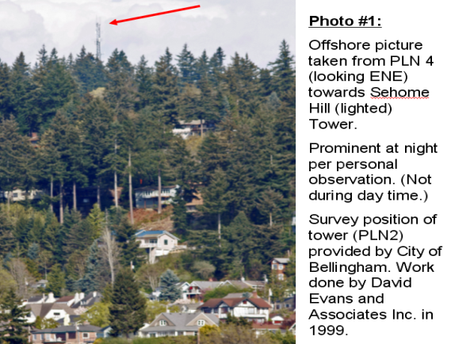
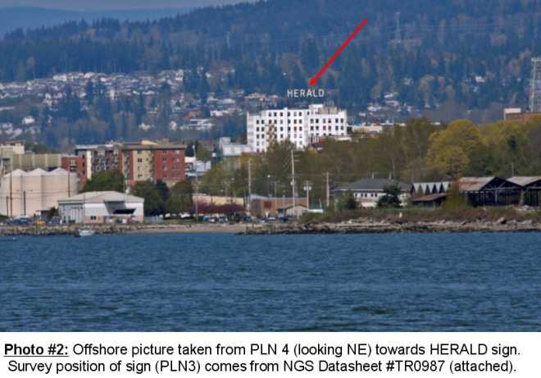
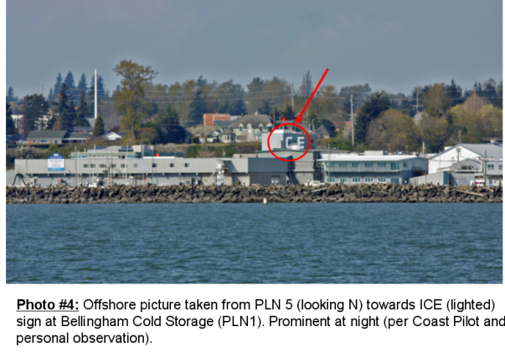
Photo Support

Slide 36
Photos are great evidence
Show the LAT/LON of the spot where the photo is taken. Plot this spot on the chartlet with a true bearing to the object.

Slide 37
Check Your Work
Before leaving an area:
Be sure your data makes sense
Stop and plot the data on a chart
Make sure that the position of the feature on the chart corresponds to the physical world
Do you have enough photos
This helps eliminate any errors . . .
. . . and possible do-overs.

Slide 38
Chart Updating
Report Submittal Overview
A few important resources that will make Chart Updating Report Submittals easy and rewarding:
Prevention Directorate, Navigation Systems Website:
http://wow.uscgaux.info/content.php?unit=P-DEPT&category=navigation-systems
-Under Navigation Systems tab are Forms, Manuals & Links, Aids Verifier PQS and Chart Updating Click on topics to provide the tools needed:
-Under the AUX-06 C-School tab you’ll find information about the school and a link to all training material for the NS Program:
Select (Required Materials) and click on AUX 06 C School Required Material http://gesture162.wixsite.com/aux-06-c-school
Bookmark the NOAA ASSIST webpage: https://www.nauticalcharts.noaa.gov/customer-service/assist/

Slide 39
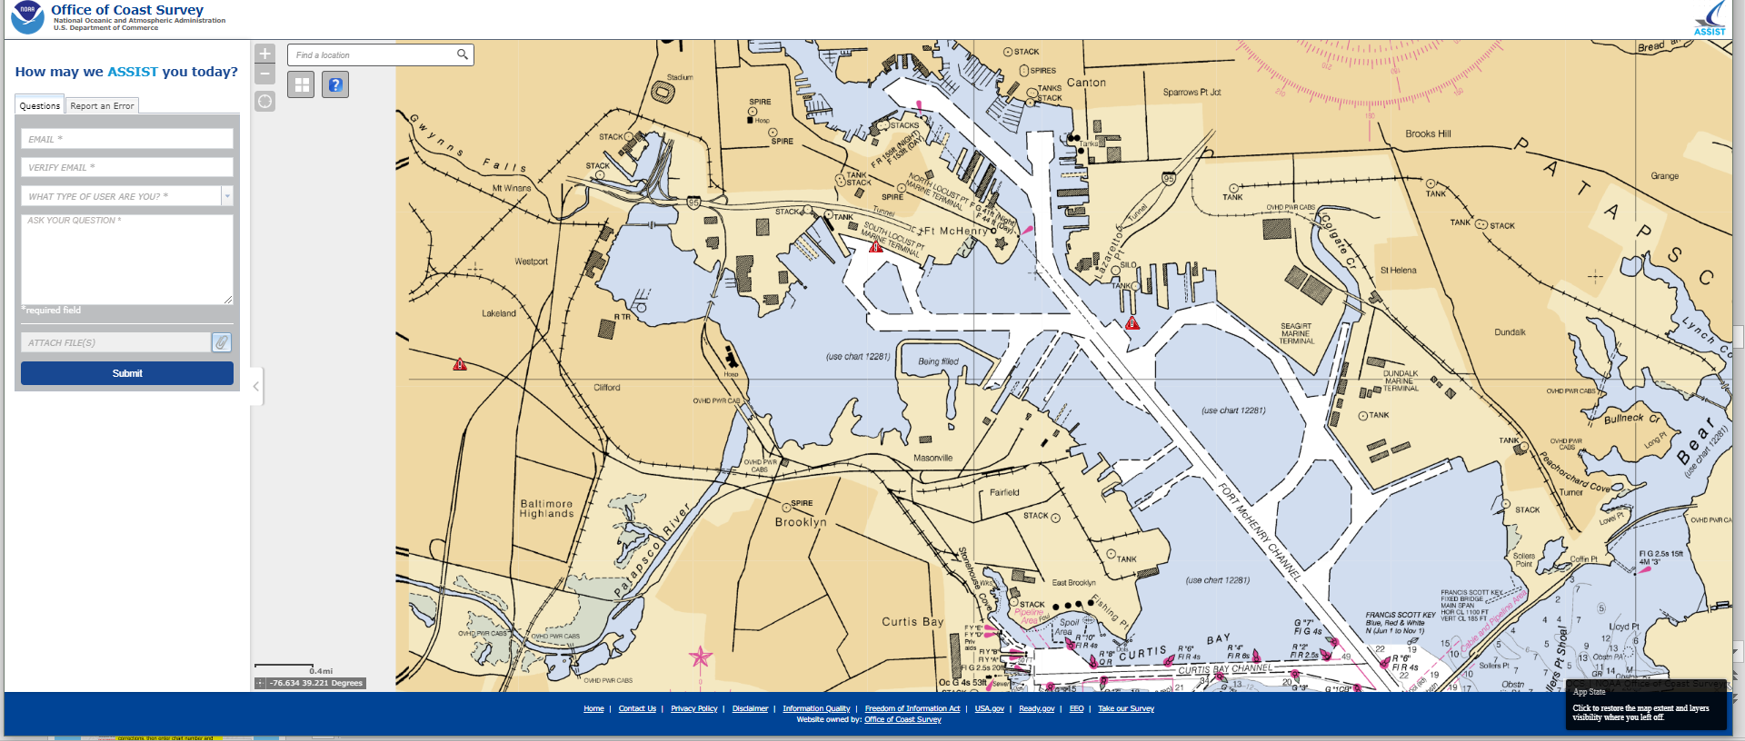
NOAA Chart Updating Report
NOAA ASSIST
ASSIST is Coast Survey’s tool, which allows customers to submit questions and comments or to report an error with NOAA’s nautical charts and products.
https://www.nauticalcharts.noaa.gov/customer-service/assist/
Notes:
The way its supposed to work is that the letter of the support file label identifies the support file and then there is supposed to be a location labelled in the file with a number. So if you have a support file "A" you may have 5 objects/locations identified in the file and their support file labels would be "A1", "A2", "A3".....

Slide 40
NOAA Chart Updating Report
NOAA ASSIST
NOAA makes it easier to submit a comment or report a nautical chart error
November 16, 2018, NOAA released ASSIST, a new system for submitting questions and reporting nautical chart errors to NOAA’s Office of Coast Survey.
ASSIST has a mobile-friendly design and improved user interface that allows customers to access the system conveniently from any device.
This new tool replaces Coast Survey’s Inquiry and Discrepancy Management System (IDMS), a database that collected nearly 20,000 comments, inquiries, and discrepancy reports since 2008.
Notes:
The way its supposed to work is that the letter of the support file label identifies the support file and then there is supposed to be a location labelled in the file with a number. So if you have a support file "A" you may have 5 objects/locations identified in the file and their support file labels would be "A1", "A2", "A3".....

Slide 41
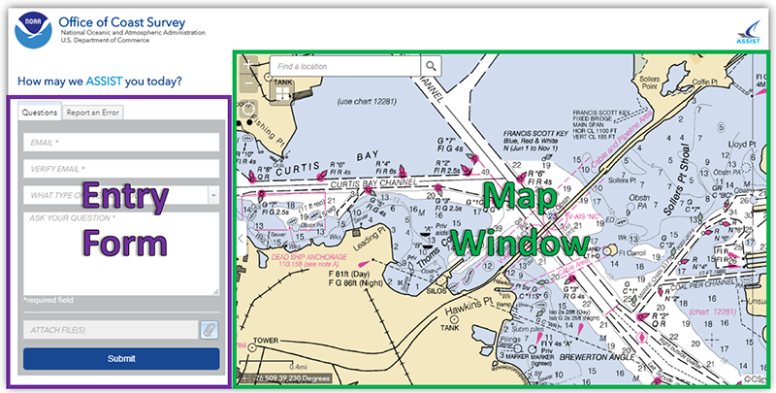
NOAA Chart Updating Report
NOAA ASSIST
ASSIST can be accessed from a computer or mobile device, such as a smartphone or tablet. ASSIST is divided into two parts – an entry form and a map window.
The entry form is used to enter information about the question, comment, or error. Required questions are denoted with an asterisk (*) .
Users also have the ability to attach files, such as images or PDF, to their submission.
Notes:
The way its supposed to work is that the letter of the support file label identifies the support file and then there is supposed to be a location labelled in the file with a number. So if you have a support file "A" you may have 5 objects/locations identified in the file and their support file labels would be "A1", "A2", "A3".....

Slide 42
NOAA Chart Updating Report
NOAA ASSIST
The map window can be used to identify the location of an error, or to see errors that have been reported by others
Notes:
Review in detail

Slide 43
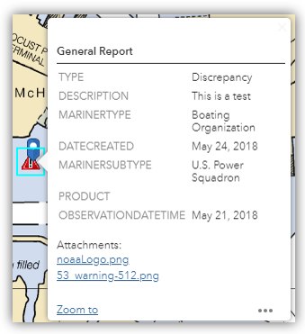
NOAA Chart Updating Report
NOAA ASSIST
Information about previously reported errors can be seen by clicking on any red triangle in the map window.
No personal information (names or e-mail addresses) will be displayed.

Slide 44
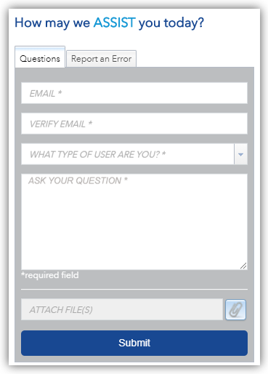
NOAA Chart Updating Report
NOAA ASSIST
Submitting a Question
To submit a question or comment, first select the “Questions” tab on the entry form.
Next, provide your e-mail address

Slide 45
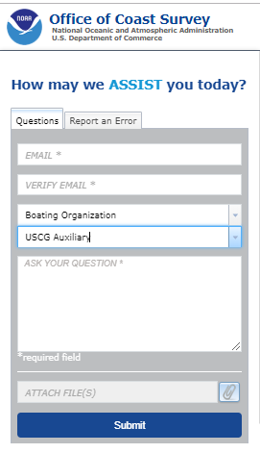
NOAA Chart Updating Report
NOAA ASSIST
Submitting a Question
Indicate your user type from the first drop down lists select “Boating Organization”
A second drop down list “Type of Boating Organization” select USCG Auxiliary
Enter your question, and add any attachments.
After you hit the submit button, you will receive an e-mail informing you that your question has been sent and providing you with an inquiry number which can be used to track your question.

Slide 46
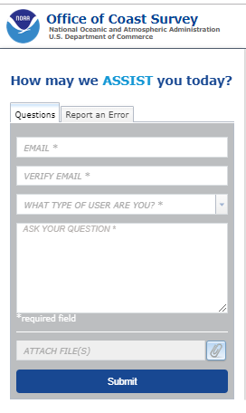
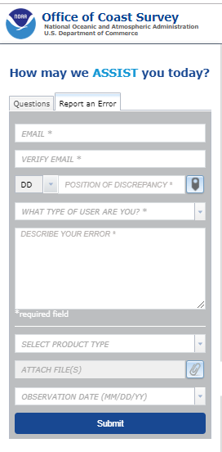
NOAA Chart Updating Report
NOAA ASSIST
Submitting a Question
Note that no position data is required to submit a question and you will not be able to choose a point on the map. You can still pan and zoom in the map window to get information about unresolved errors.

Slide 47
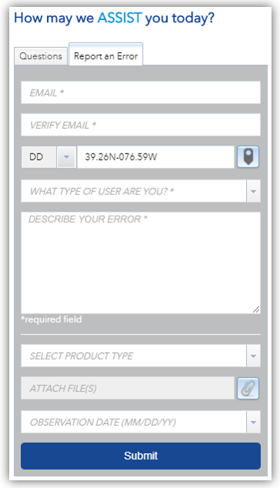
NOAA Chart Updating Report
NOAA ASSIST - Reporting Errors
Next open the ASSIST interactive page.
To report an error, select the “Report an Error” tab on the Entry Form.
Add the information that is required, your email address
It is also necessary to provide the position of the error and the product that you are using.
Positions can either be entered manually, by typing in the coordinates or by selecting a location on the map.

Slide 48
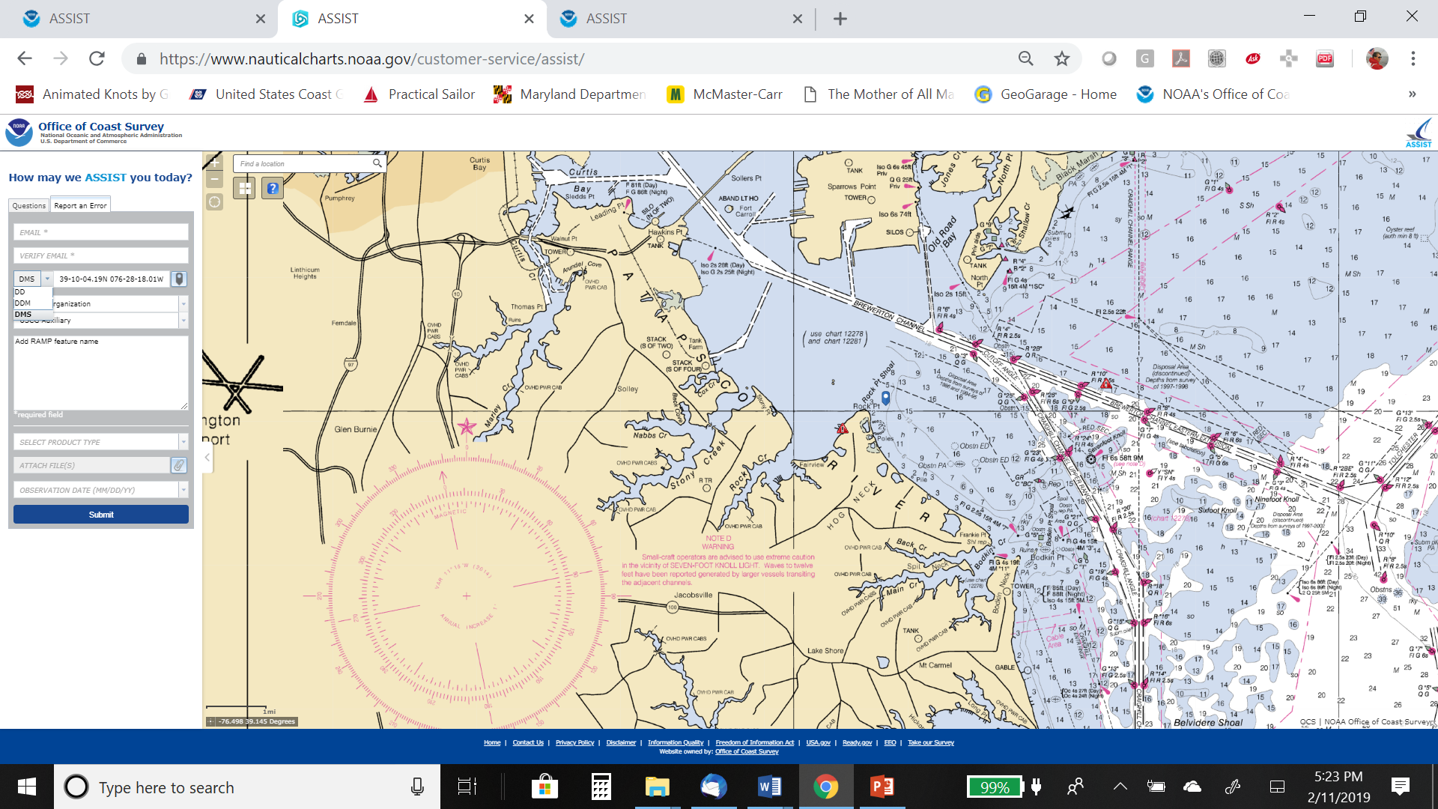
NOAA Chart Updating Report
NOAA ASSIST
To enter the position manually, first choose the preferred format and enter the coordinates as shown:
DD decimal degrees (ex. 39.24N 076.56W)
DDM degrees & decimal minutes
(ex. 39 14.19N 076 33.36W)
DDS degrees, minutes, and decimal seconds (ex. 39 14 11.40N 076 33 21.60W)

Slide 49
NOAA Chart Updating Report
NOAA ASSIST
To enter the position via the map, first click the point icon . The entry form will disappear and the map window will expand. Use the tools in the top left corner to pan and zoom, then click on your desired location.
A new blue symbol will show up where you clicked and the position of your point will be automatically populated in the user form.
Unless a specific single feature such as a pile or rock, this position can be the center of a feature such as a foul area, new marina or any large continuous area.
To return to the user form without selecting a point, click the arrow on the left side of the map window.

Slide 50
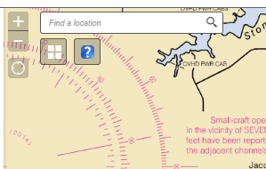
NOAA Chart Updating Report
NOAA ASSIST
Use the tools in the top left corner
Geographic place name
Zoom in and out, over zoom will cause the map to disappear.
My Location, center on your location
Base Map Gallery, change look of the map graphic
Link to Help screen
https://beta-development.azurewebsites.net/customer-service/assist.html

Slide 51
NOAA Chart Updating Report
NOAA ASSIST
Blue symbol will show up where you clicked point will be automatically populated
To return to the user form, click the arrow on the left side of the map window

Slide 52
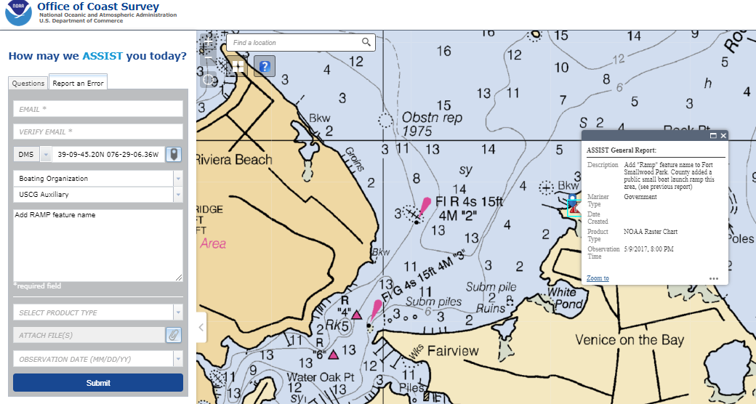
NOAA Chart Updating Report
NOAA ASSIST
Describe The Error
Briefly describe what corrections are needed (Add pier, Delete tower, Revise the name, etc.).

Slide 53
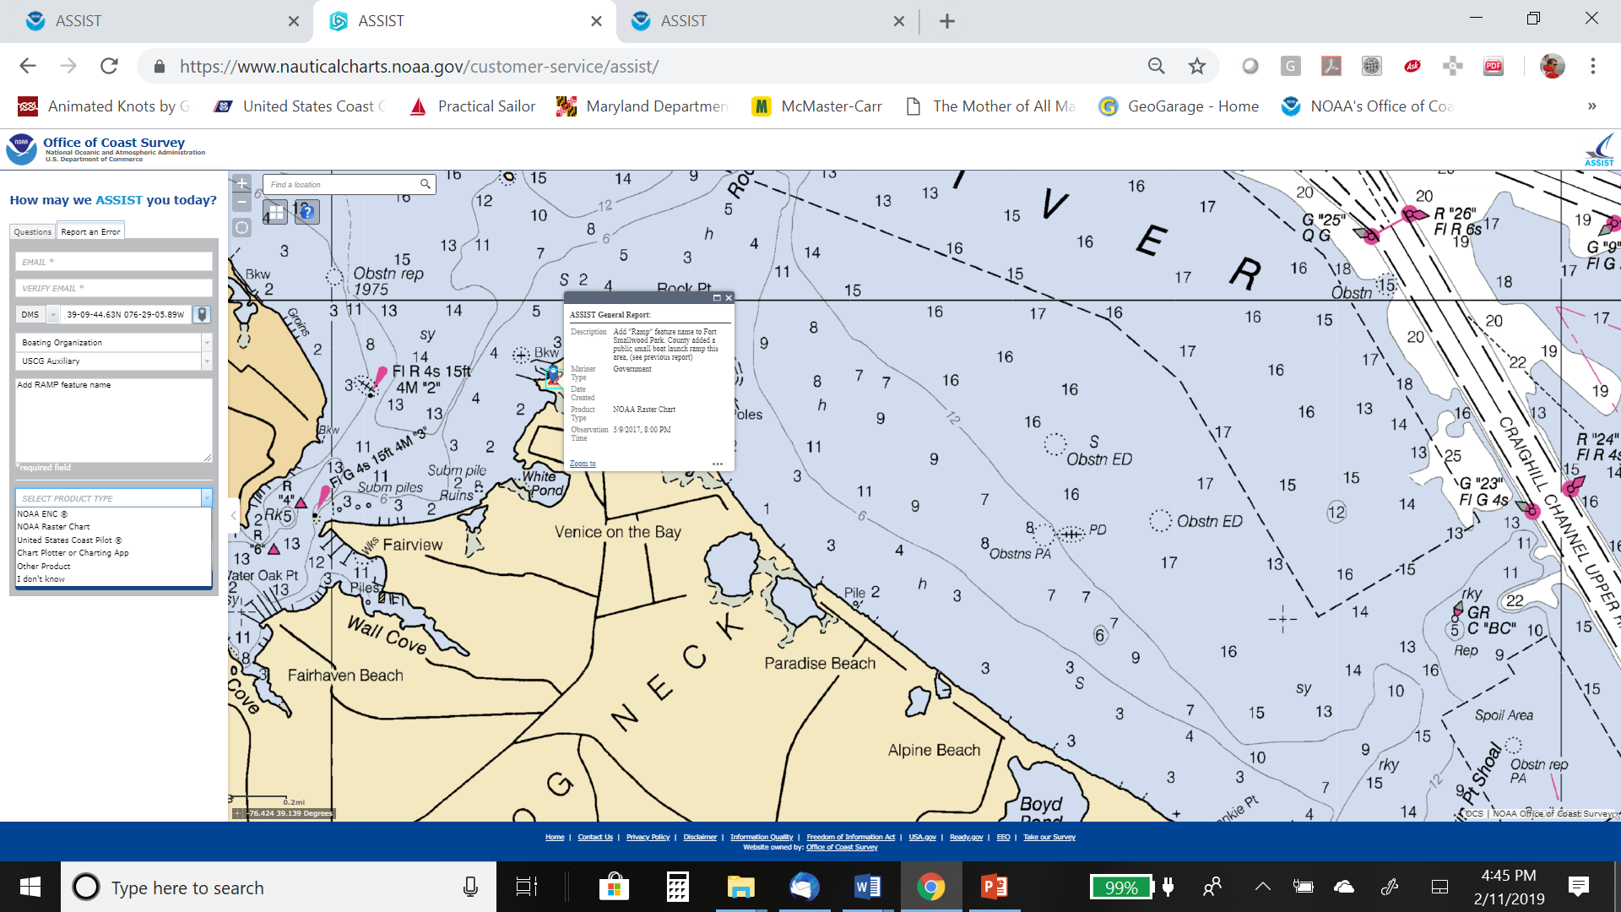
NOAA Chart Updating Report
NOAA ASSIST
Select Product Type from the drop down menu, this is where you select a Chart product Update OR a Coast Pilot Update.

Slide 54
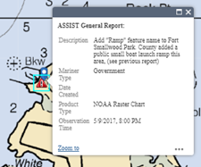
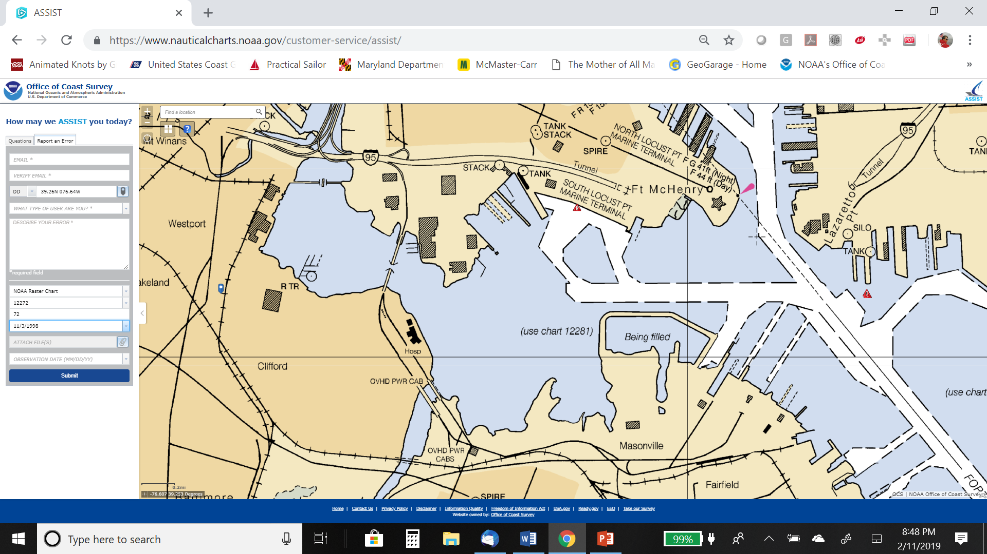
NOAA Chart Updating Report
NOAA ASSIST
If you used the appropriate fillable PDF form to record information about the discrepancies. You may use this information to fill in the product information.
The drop downs change according to product type, i.e.
“US Coast Pilot”, only asks for Volume Number, “Chart Plotter” asks for manufacturer model and version)

Slide 55
NOAA Chart Updating Report
NOAA ASSIST
Upload the supporting files from your directory
Select all your data files and hit open and your files will be copied to ASSIST
Add all supporting files at one time from their directory.
To check the files you entered just hover your pointer over the box and the files will show in the pop-up window.
Don't click on the box again to add more files, your previous uploaded files will disappear.

Slide 56
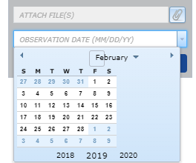
NOAA Chart Updating Report
NOAA ASSIST
You also enter the date that the error was observed or work performed.

Slide 57
NOAA Chart Updating Report
NOAA ASSIST
After describing the error, add any attachments (all those previous Discrepancy Forms and other worksheets, etc.). After you hit the submit button, you will receive an e-mail informing you that your submission has been sent and providing you with an inquiry number which can be used to track your submission.
OCS Inquiry: 32979
Original message: Add "Ramp" feature name to Fort Smallwood Park. County added a public small boat launch ramp this area, (see previous report) 12278. REF ASSIST 2765
OCS response: Thank you for your inquiry. The changes have been made to the largest scale Raster chart and ENC. They will be available in the next update.
------------------------------------------------------------

Slide 58
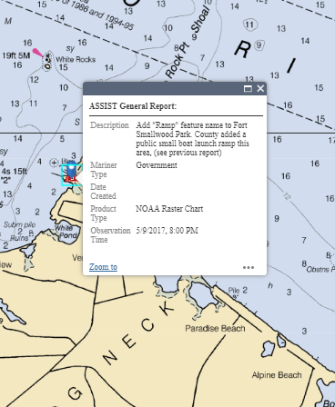
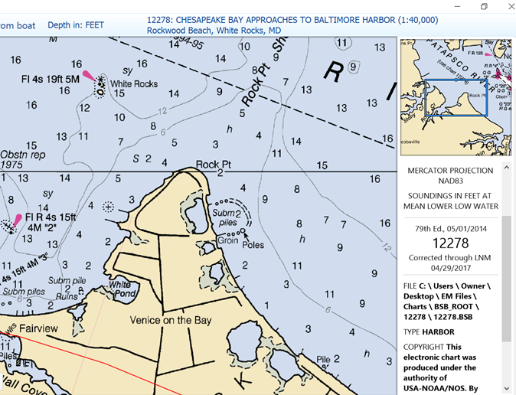
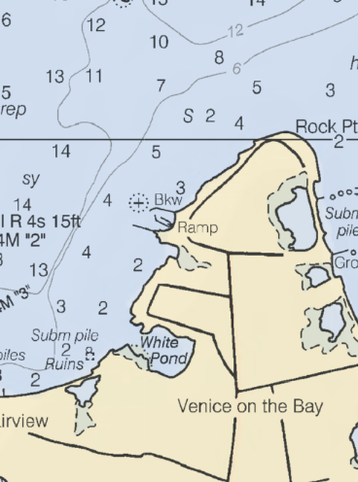
NOAA Chart Updating Report
NOAA ASSIST
Report
Before
After

Slide 59
NOAA Chart Updating Report
NOAA ASSIST
ASSIST offers new features including the ability to:
Enter reports from a cell phone
Tag your submission on a NOAA chart, map, or satellite imagery
or other mobile device
Comment or report an error using a single form
These improvements streamline the internal Coast Survey workflow.

Slide 60
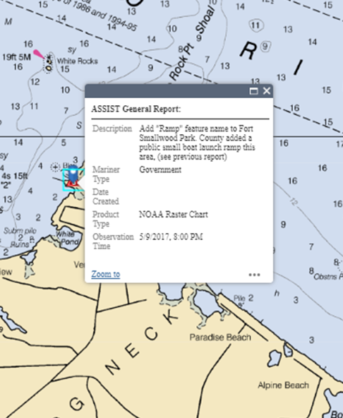
NOAA Chart Updating Report
NOAA ASSIST
Some problems have been noted:
NOAA ASSIST is not password protected, anybody can access the information. This means that any personal data would be exposed.
There is no access to the report once submitted to NOAA, other than opening the ASSIST General Report box.
That means no review by NS Staff. If the DSO or SO want to review your submission we suggest the following:
Full page Closeout

Slide 61
NOAA Chart Updating Report
NOAA ASSIST
Some problems have been noted:
Suggest open NOAA ASSIST and Clicking on red triangle in the map window and you will see ASSIST General Report box open with an overview of your submission.
Suggestion is to email a copy of your report and the email note from NOAA through your NS Chain of Leadership.
You can not save your work in NOAA ASSIST, closeout your computer and come back to it later, so have all your data ready before starting.

Slide 62
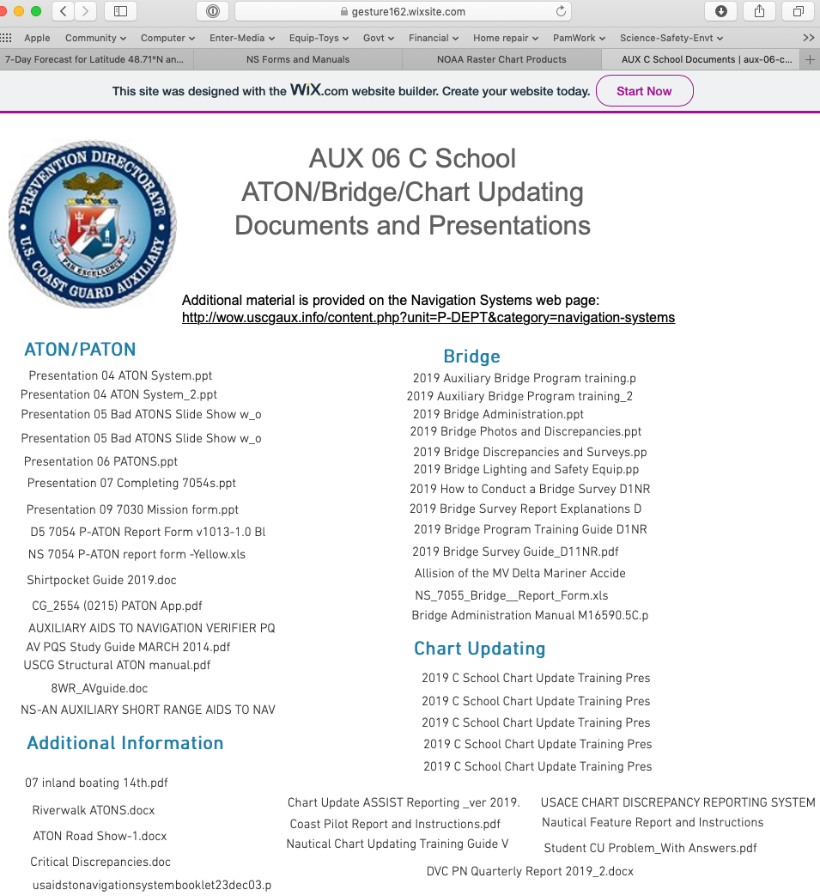
Discrepancy Report (Optional)
There are two different fillable PDF Discrepancy forms available for supporting the data you will submit through NOAA’s ASSIST webpage – Nautical Feature and Coast Pilot.
Use the appropriate fillable PDF form to record discrepancies. Save that PDF form when you reach that step in the instructions.
All this material is available on: https://gesture162.wixsite.com/aux-06-c-school

Slide 63
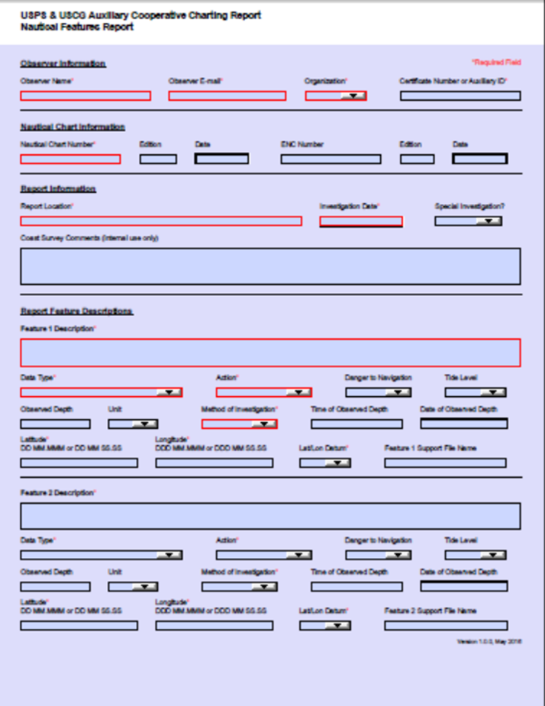
Discrepancy Report (Optional)
This fillable .pdf report/worksheet will assist you in recording discrepancies for Nautical Features
In addition to the fillable PDF form, upload additional documents to support your discrepancy reports.
Optional NS Chart Updating Worksheets are still valid as supplemental information
Note: If you print out this fillable pdf form for use on patrol, the boxes around the drop down selections will not print.

Slide 64
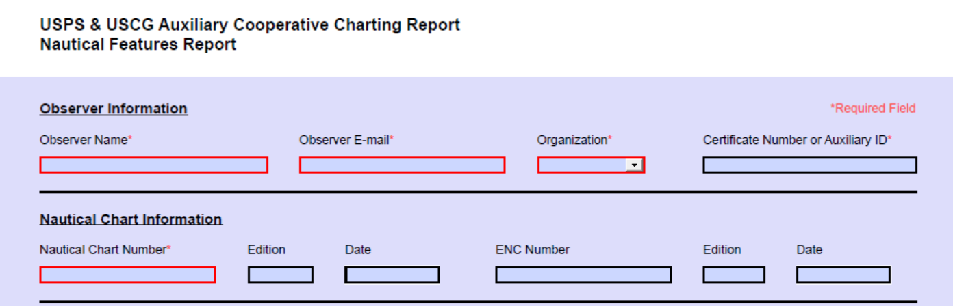
Discrepancy Report (Optional)
Observer Information
Observer Name* Member Full Name (first and last)
Observer E-mail* Primary Email address used for Auxiliary contact
Organization* Pick from drop down menu (USPS, USCG Aux)
Certificate Number or Auxiliary ID* Member ID number
Nautical Chart Information
Nautical Chart Number* NOAA Nautical Chart Number (should be largest scale)
Edition Edition Number
Date Date of last LNM correction (DD/MM/YYYY)
ENC Number ENC Number
Edition Chart Edition Number
Date Date of last LNM correction (DD/MM/YYYY)

Slide 65
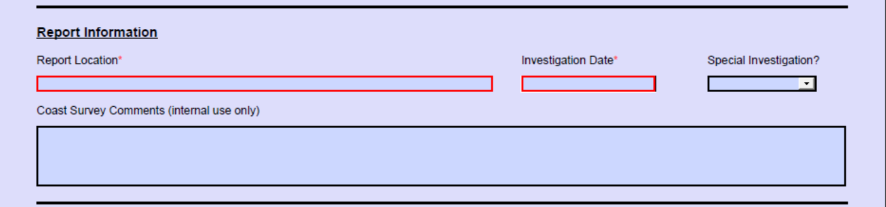
Discrepancy Report (Optional)
Report Information
Report Location* NOAA Chart name and/or place name
Investigation Date* Date of visit (DD/MM/YYYY)
Special Investigation? Pick from drop down menu
(YES if investigation was requested by USCG or NOAA, otherwise NO)
Coast Survey Comments NOAA internal use only (Do not fill this box)

Slide 66
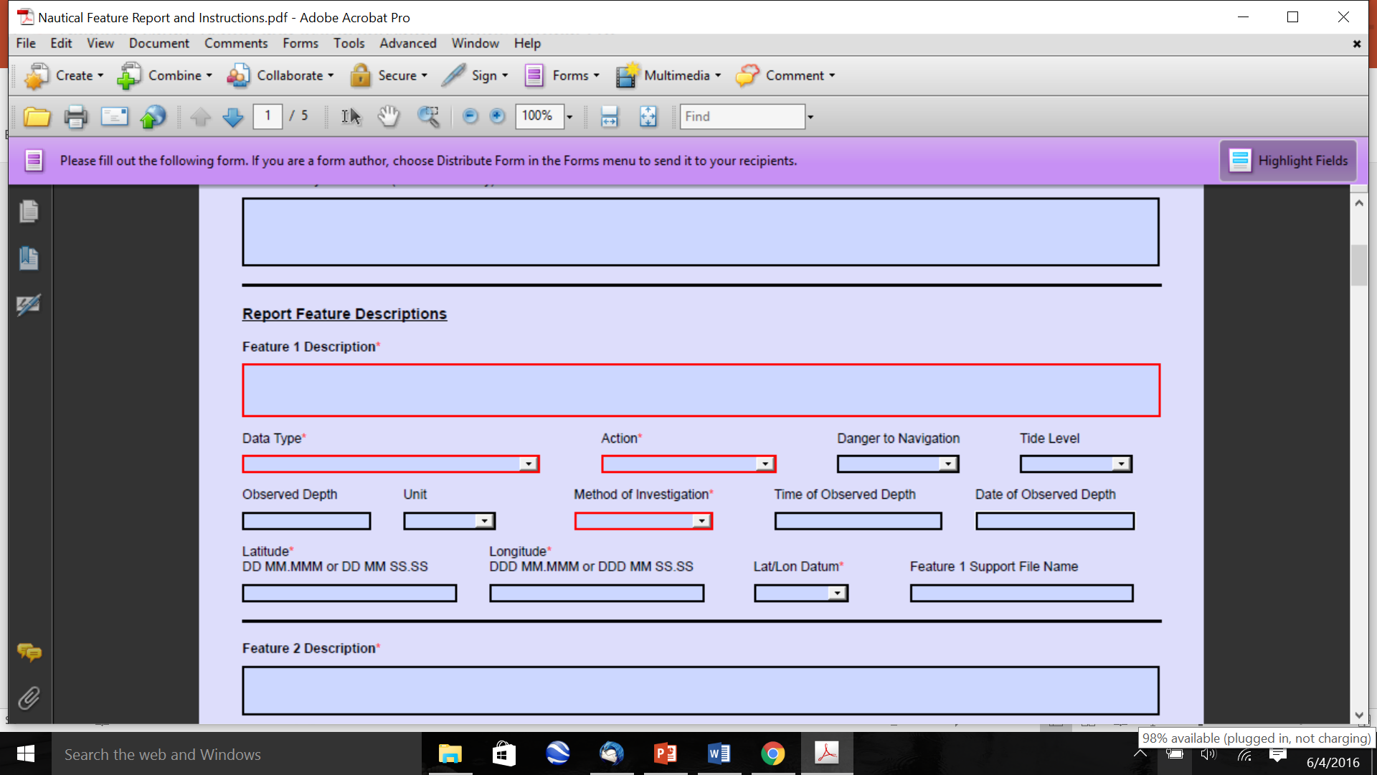
Discrepancy Report (Optional)
Report Feature Descriptions
Feature 1 Description* Brief description of feature you’re reporting on
Data Type* Pick the feature from the pull down menu:
  Artificial Reef Obstruction
  Boat Ramp Overhead Cable
  Bridge Pier / Dock
  Dam Pile / dolphin
  Depth Legend Platform
  Discrete Point Danger Rock
  Duck Blinds Shoal
  Fish Stakes Sign / Marker
  Geographic Name (must include GNIS entry) Submerged Cable
  Landmark Wreck
  Note Change Other
Action* Pick the charting action to be taken from the pull down menu:
  Add Change and Relocate
  Delete Damaged/Missing
  Change Correct as Charted
  Relocate

Slide 67
Discrepancy Report (Optional)
Report Feature Descriptions (Continued)
Danger to Navigation Pick from drop down menu (YES, if without the corrective action taken the feature will pose a danger to navigation, otherwise NO)
Tide Level The current drop down menu asks you to pick from:
Flood Tide (current, not used)
High Tide
Ebb Tide (current, not used)
Low Tide
Unknown
Note: NOAA is considering the option to enter a Tide level value computed by the observer.

Slide 68
Discrepancy Report (Optional)
Observed Depth The depth of water at the time of observation
Unit Select from the drop down menu the unit of measure:
  Feet Meters
  Fathoms Other
Method of Investigation* Select from drop down menu what was used to obtain the depth:
  Visual Pole Sounding
  Lead Line Echo Sounder
  Other
Time of Observed Depth Enter the time using standard 24-hour clock and include the time zone of the observation
Date of Observed Depth Enter the date the depth was taken (DD/MM/YYYY)
Latitude* DD MM.MMM or DD MM SS.SS
Longitude* DDD MM.MMM or DDD MM SS.SS
Lat/Lon Datum* Select from the drop down menu the Datum set in your GPS/WAAS or other unit:
  NAD 83 WGS 84
  NAD 27 Unknown
Note: Consideration is being made to include information on positioning equipment

Slide 69
Discrepancy Report (Optional)
Feature 1 Support File Name Enter the file naming convention to be used on your report, such as Name_New_Boat_Ramp.
List the files i.e. name_new_boat_ramp_001.pdf, name_new_boat_ramp_002.jpg, etc. for this item in the box for Additional Information at the end of this form.
The only caveat is the associated files must not include any special characters other than the underscore symbol. Spaces in file names are prohibited.
Repeat the Report Feature Description section process for additional Feature 2 - 5 Description’s observed for the chart listed.
Currently if more than five separate features reported on the same chart you will have to complete another Feature Report.
*Required Field

Slide 70
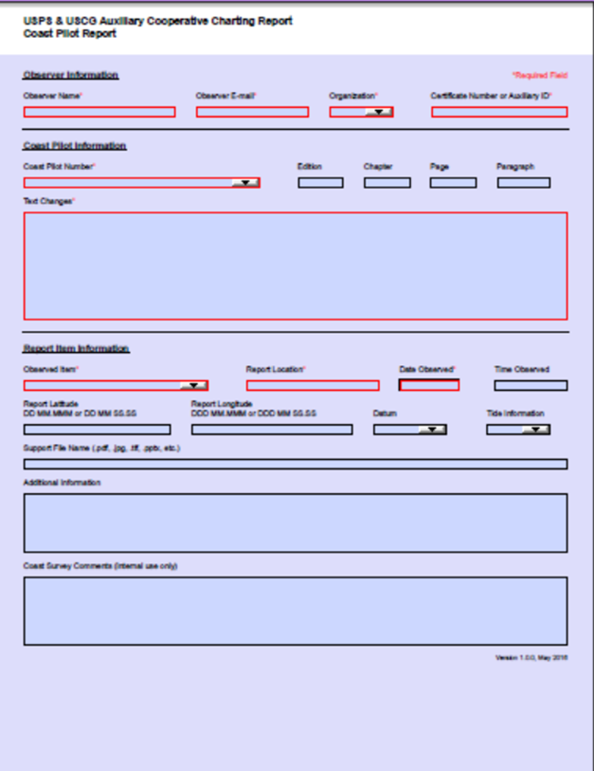
Discrepancy Report (Optional)
Coast Pilot
This fillable .pdf report/worksheet may be appended to NOAA’s ASSIST Form
Use the appropriate fillable .pdf form to record discrepancies. Coast Pilot
You may upload one or more files in addition to this fillable .pdf form.
Do not change the file name of the this fillable .pdf file.
These fillable .pdf reports are available from https://gesture162.wixsite.com/aux-06-c-school
Note: If you print out this fillable pdf form for use on patrol, the boxes around the drop down selections will not print.
Notes:
2003 Aids to Navigation Workshop
70

Slide 71
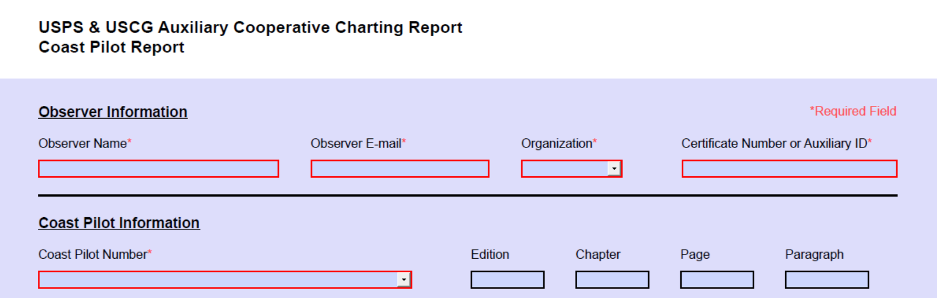
Discrepancy Report (Optional)
Coast Pilot
Observer Information
Observer Name* Member Full Name (first and last)
Observer E-mail* Primary Email address used for Auxiliary contact
Organization* Pick from drop down menu (USPS, USCG Aux)
Certificate Number or Auxiliary ID* Member ID number

Slide 72
Discrepancy Report (Optional)
Coast Pilot
Coast Pilot Information
Coast Pilot Number* Pick from drop down menu the USCP number and region:
USCP 1 - Atlantic Coast: Eastport ME to Cape Cod, MA USCP 6 - Great Lakes and their connecting waterways
USCP 2 - Atlantic Coast: Cape Cod, MA to Sandy Hook, NJ USCP 7 - Pacific Coast: CA, OR, WA, HI and Pacific USCP 3 - Atlantic Coast: Sandy Hook, NJ to Cape Henry, VA Islands
USCP 4 - Atlantic Coast: Cape Henry, VA to Key West, FL USCP 8 - Alaska: Dixon Entrance to Cape Spencer
USCP 5 - Gulf of Mexico, Puerto Rico and Virgin Islands USCP 9 - Alaska: Cape Spencer to Beaufort Sea
Edition Edition Number
Chapter Reference the Chapter number
Page Reference the page number located at top left or right of each page
Paragraph Reference the paragraph Number located a top left of paragraphs

Slide 73
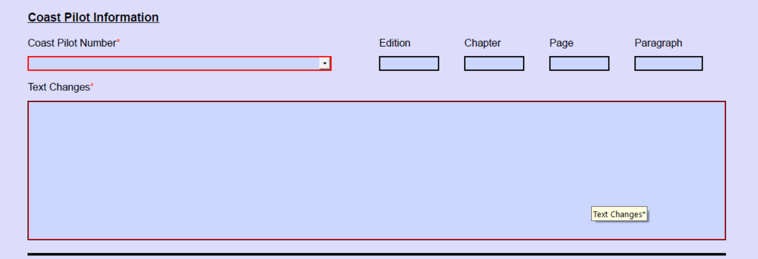
Discrepancy Report (Optional)
Coast Pilot
Text Changes* Include the line changes in the allotted space

Slide 74
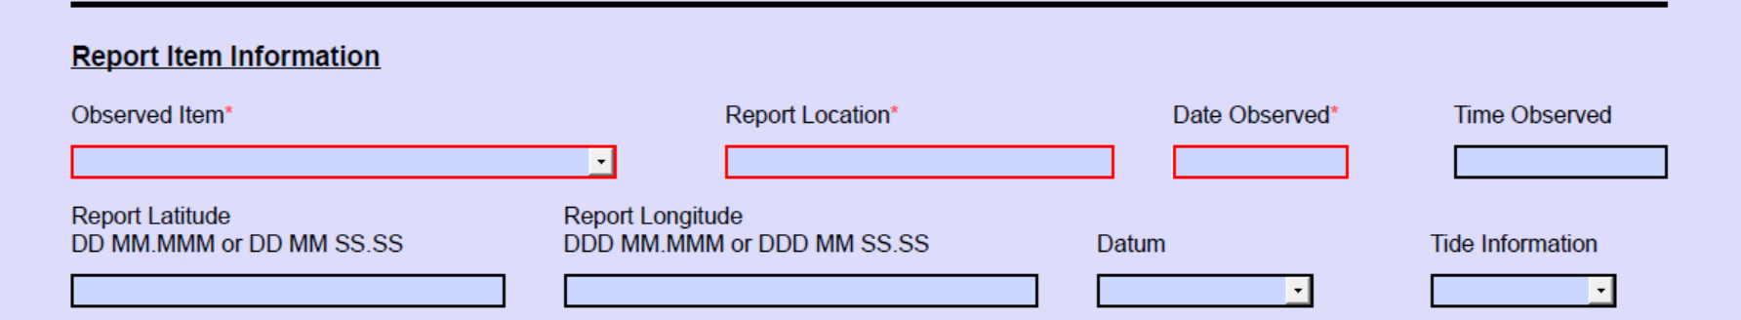
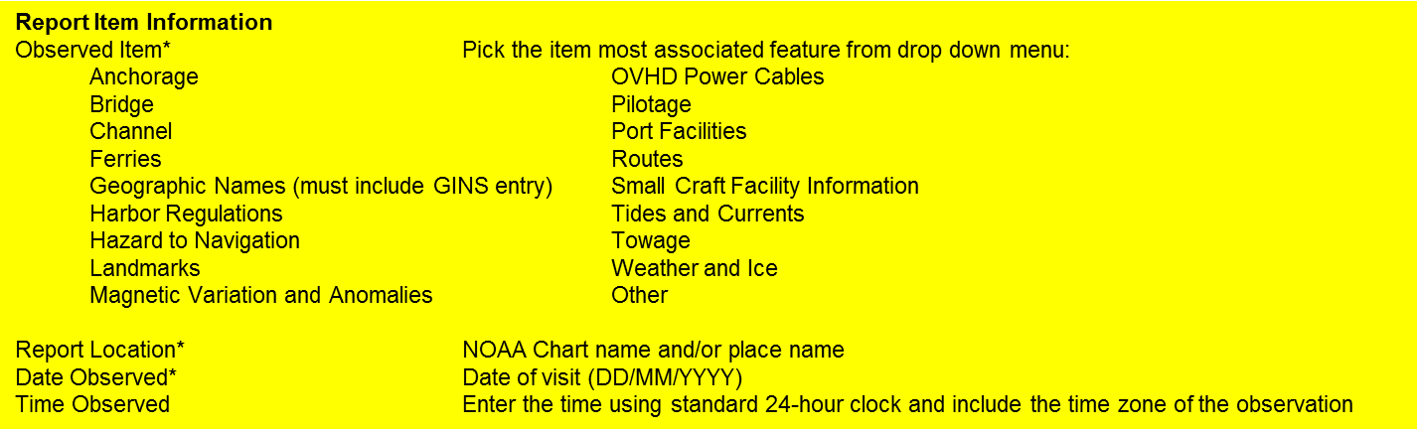
Discrepancy Report (Optional)
Coast Pilot

Slide 75
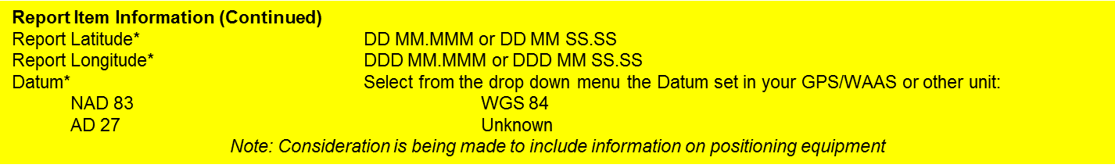
Discrepancy Report (Optional)
Coast Pilot
Tide Level The current drop down menu asks you to pick from:
  High Tide
  Low Tide
  Unknown
Note: NOAA is considering the option to enter a Tide level value computed by the observer.

Slide 76
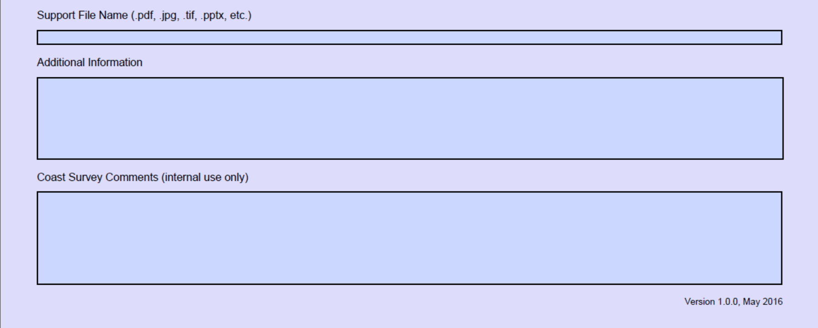
Discrepancy Report (Optional)
Coast Pilot
Support File Name Enter the file naming convention to be used on your report, such as Name_New_Boat_Ramp. (.pdf, .jpg., .tif,. .pptx, etc.)
Additional Information List the files i.e. name_new_boat_ramp_001.pdf, name_new_boat_ramp_001.jpg, etc. for this item in the box for Additional Information at the end of this form.
The only caveat is the associated files must not include any special characters other than the underscore symbol. Spaces in file names are prohibited.
Coast Survey Comments (internal use only) Do not fill this box
*Required Field

Slide 77
RESULTS OF
CHART UPDATE REPORTING
Why some report submissions get corrected to the chart and some don’t:
The Chartability of an object depends on its size in relationship to the scale of the chart.
Object plotted on a large scale may not appear on a smaller scale chart
Can the object be depicted clearly on the chart
Is the object of navigational significance, will it aid the mariner in navigating safely
NOAA Cartographer will evaluate reports and is responsible for charting action taken

Slide 78
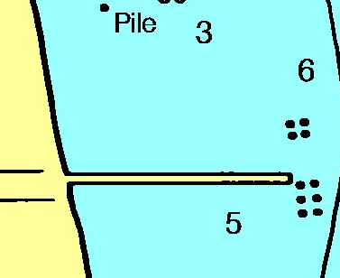
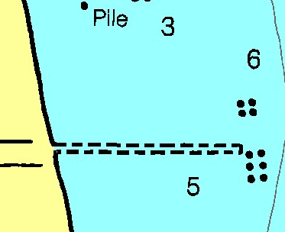
Reported Removed
NOAA chart as “ruins”
Old Chart
New Chart
Notes:
The result of that report was to chart the pier in ruins because either no salvage documentation could be obtained nor was any investigation done from the water to disprove the possibility of any ruins.

Slide 79
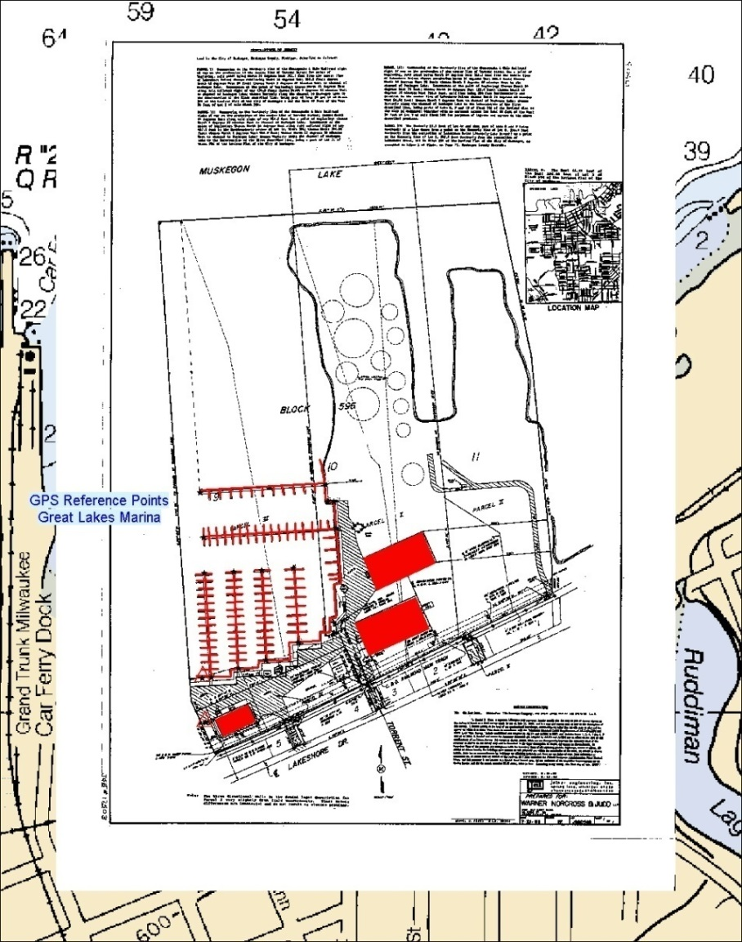
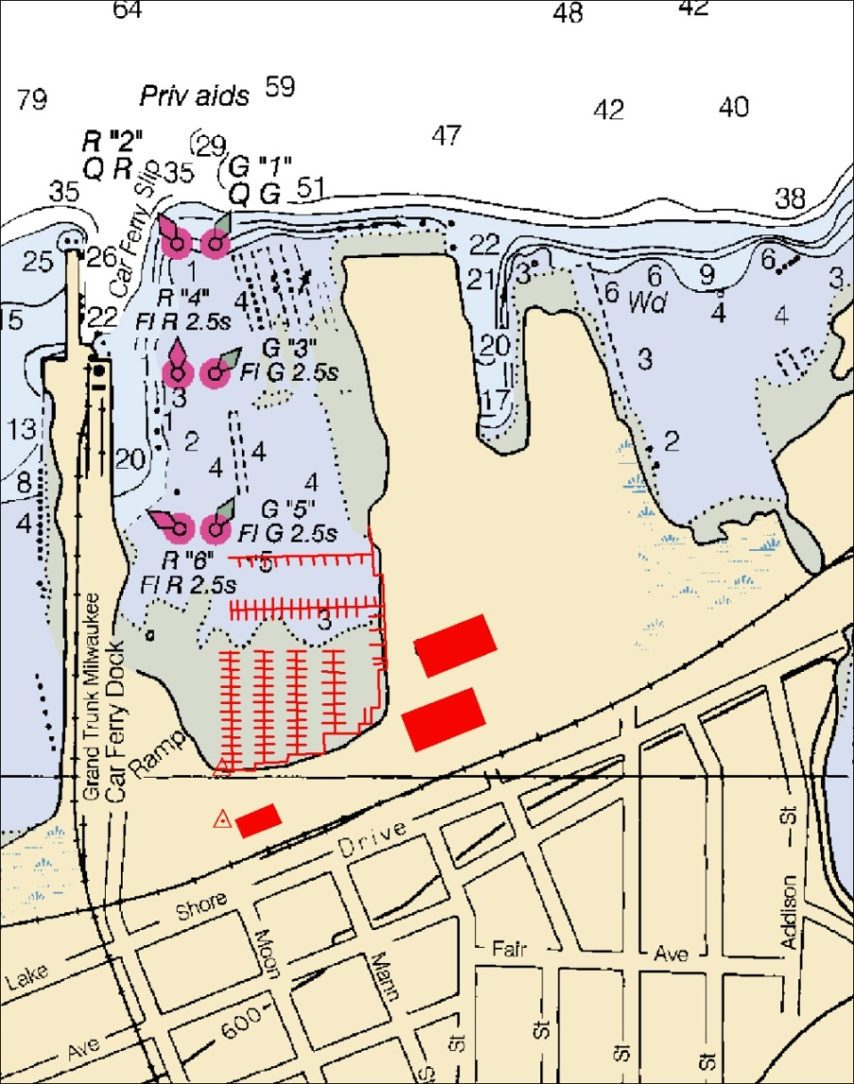
Using As-built Drawings
Tracing made of new marina using field geo-referenced as-built drawing
As-built drawing layer removed to show chart correction
Notes:
Explain the process shown.

Slide 80


Baltimore Inner Harbor Changes
Submerged Piles Moved
Lighthouse and bridges added
New Marina
Depths in harbor changed
Major changes in shoreline, marina added
Federal project channels discontinued
Lighted tower added
Cultural features suppressed

Slide 81


Features Before and After
Fixed Red light removed
Railroad tracks removed
Notes:
This is the results of that report. And again while maybe not seeming very significant, every change is important in making the charts completely accurate. Some of these features have been gone for years and when a person knows it’s been removed years ago but is still showing up on the chart, they begin to wonder about the overall accuracy of the chart.

Slide 82



Visible Wreck Not Found
Report
Old Chart
New Chart
Wreck Removed
Notes:
Note in the original PS report that the inspector performed several dives in the area.

Slide 83
Your input matters
You, the mariner or facility owner, use NOAA navigational products in a dynamic marine environment.
We encourage you to submit inquiries, comments or discrepancies about navigational products.
Your feedback can lead to chart or Coast Pilot corrections.

